Slide 1
ABDOMINAL MASSES IN CHILDHOOD
DR. FIONA ANYUMBA

Slide 2
ABDOMINAL MASSES IN CHILDHOOD
Not a ‘small adult:
Different constraints in choice of imaging modalities; non-ionizing radiation preferred
Greater emphasis on congenital abnormalities
Incidence of malignant disease increases with increasing age

Slide 3
IMAGING MODALITIES
Plain radiographs
Ultrasound scanning
Computerized Tomography (CT)
Nuclear Medicine
Intravenous Urography (IVU)
Angiography
Magnetic Resonance Imaging (MRI)

Slide 4
Plain Radiographs:
Of limited use;
- ? abdominal mass
- Displaced bowel loop gas, air-fluid levels – location, size
- Associated skeletal abnormalities e.g. metastatic disease
- Complimentary CXR - ? pulmonary metastasis e.g in neproblastoma, hepatoblastoma

Slide 5
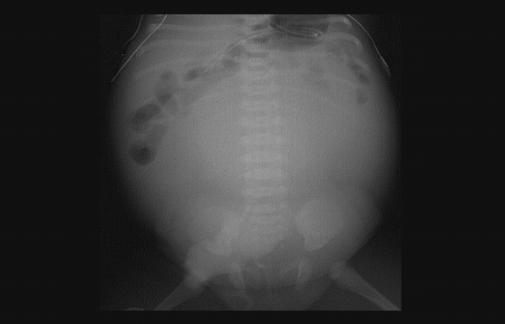
Pelvic Mass Rising Into Lower Abdomen

Slide 6
Ultrasound Scanning:
First examination of choice in neonate and child presenting with an abdominal mass. Aids in;
- Localization of mass
- internal structure of mass – cystic/solid among other characteristics
-Vasculature – Doppler and color flow
- Guide percutaneous biopsy for histopathological diagnosis

Slide 7
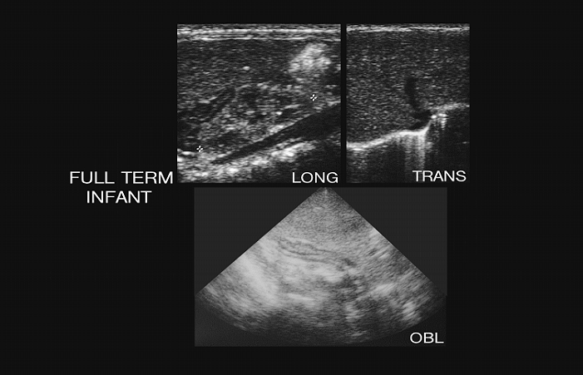
Normal Adrenal Gland
US

Slide 8
Computerized Tomography:
- adjunct to ultrasonography
- next investigation of choice
- additional anatomical information
- however – ionizing radiation
- requires sedation for those below 5 years
- only used when distinct benefits are identified

Slide 9
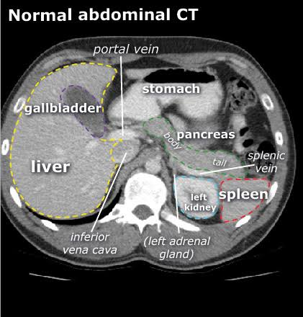

Slide 10
Nuclear Medicine:
Evaluation of function e.g.
- renal scan in assessment of renal function in cases of hydronephrosis

Slide 11
Angiography:
Largely replaced by US, CT and MRI in the investigation and diagnosis of abdominal masses
However, useful pre-op assessment of a tumor, particularly liver tumors – can demonstrate vascular supply of tumor from liver ? arterial ? portal venous

Slide 12
Magnetic Resonance Imaging:
- no ionizing radiation
- multiplanar scanning
and therefore useful tool in investigation of children with abdominal masses
- requires relatively long periods of immobility and therefore sedation / general anaesthesia is required for those under 6 years.
- not widely available

Slide 13
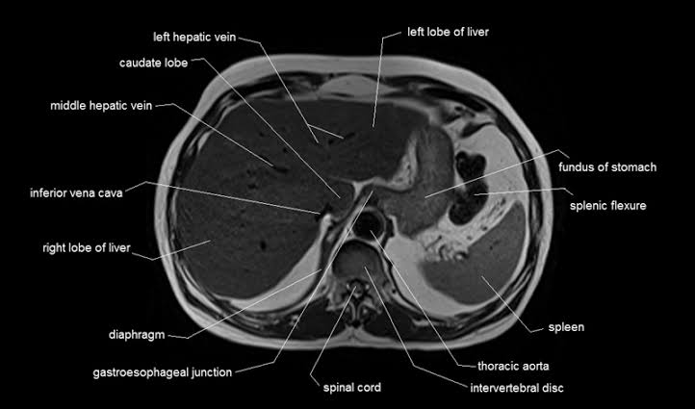

Slide 14
ABDOMINAL MASSES
Masses presenting in childhood in the abdomen can be divided into 4 broad categories:
1. Retroperitoneal:
- renal
- non-renal
2. Hepatobiliary
3. Gastrointestinal
4. Pelvic/Genital

Slide 15
NON-RENAL RETROPERITONEAL (10%)
Adrenal hemorrhage
Neuroblastoma
Teratoma

Slide 16
GASTROINTESTINAL (15%)
Duplication
Volvulus
Cystic meconium peritonitis
Mesenteric cyst

Slide 17
PELVIC/GENITAL (15%)
Ovarian Cyst
Hydrometrocolpos

Slide 18

END

